Slide 1

ParkSavvy
Mobile
App
ParkSavvy is an innovative parking assistance app that aims to reduce parking violations and time spent searching for spots by notifying users of parking restrictions and suggesting available spaces.
Notes:
Pitching Tesla company
Hello! I am here to present about my company that’s called ParkSavvy. It’s an innovative parking assistance app that aims to reduce parking violations and time spent searching for available spots. Parking in cities like San Francisco is stressful, time-consuming and potentially very expensive. On average, people spend up to 4 days a year looking for a parking spot in the city. On top of this, the city hands out millions of dollars of fines to people who may have lost track of time or were too confused by all the different rules.

Slide 2

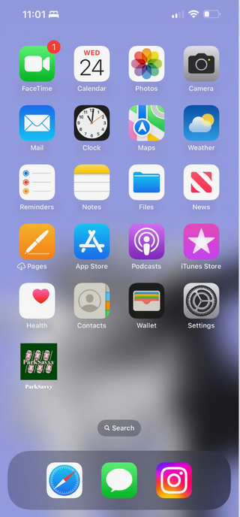
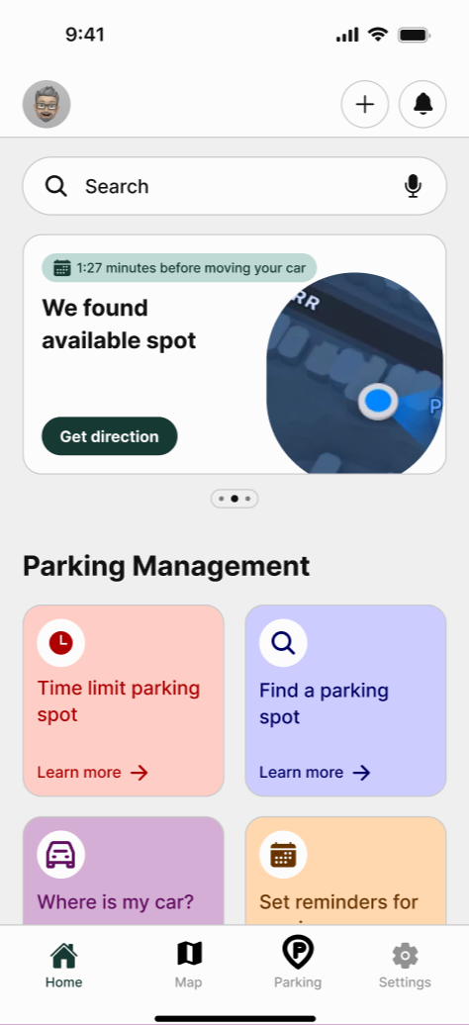
ParkSavvy
Welcome To ParkSavvy
ParkSavvy is an app that helps users navigate parking in San Francisco by explaining time zones, parking rules, and signs. Its main goal is to prevent parking ticketsThe app will be available for all customers in the app store, especially featuring options exclusive to Tesla customers.
Notes:
ParkSavvy is here to save them! We are building capabilities such as clearly explaining parking rules including time limits, sign details, and street cleaning, and expanding these to new AI and vision driven scenarios in the coming months.

Slide 3
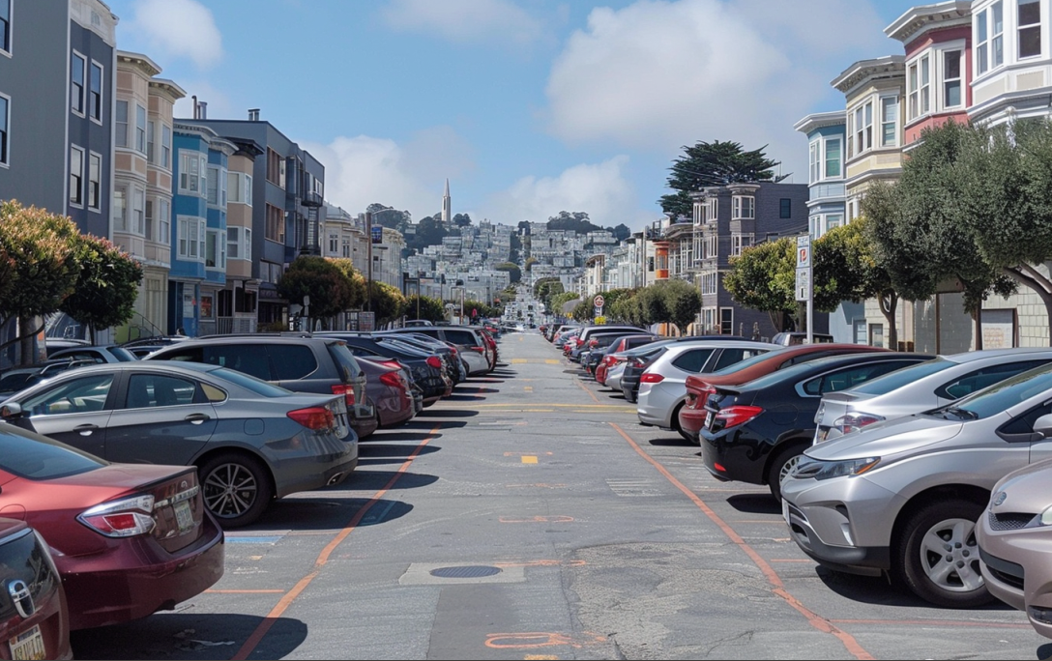
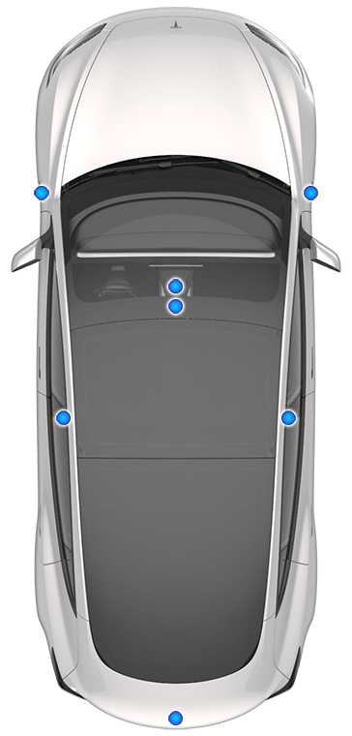
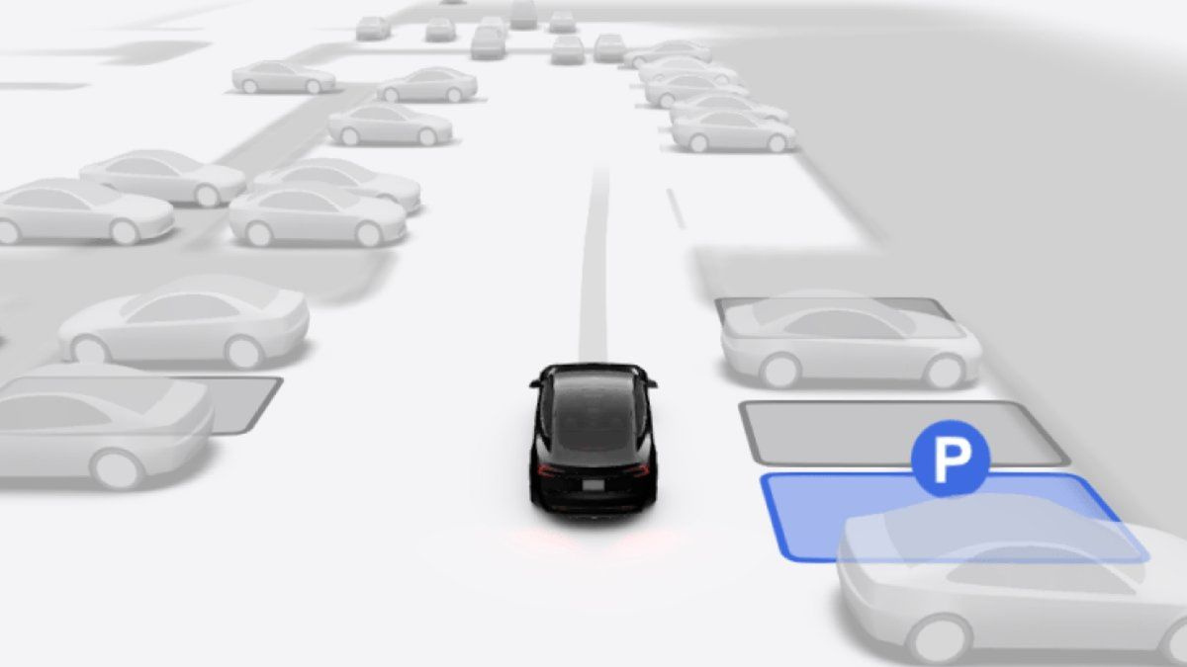
ParkSavvy
Aid Parking
Features
Our first-generation AI will provide you an estimation based on probability where you can find a parking spot that meet your needs.
01
02
The future version of our app will include the aid of existing cameras integrated in cars. AI will process images to find you the closest parking spot for your car and provide you with directions promptly.
03
Tesla cars can autonomously move to a new parking spot. Remain where you are and check the app for the updated parking location.
Notes:
We wanted to come to you at Tesla because we think a partnership could be a great differentiation from other electric car manufacturers. We want to explore a potential integration, where Tesla owners can get this type of assistance directly in the Tesla app. We would love to explore how we could tie in these types of capabilities, including predicting where you can find parking spots, and soon some exciting new features such as visually scanning streets and available parking spots. We would also love to explore potential collaborations to unlock even more value, such as through the vision systems built into your cars. We want to see how far we could take this over the coming years, such as automatically moving the car to another parking spot when needed or picking you up when you have finished shopping.

Slide 4

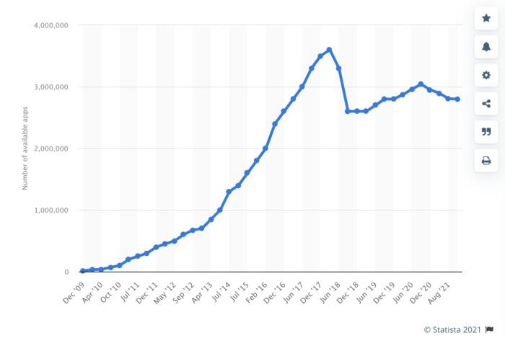
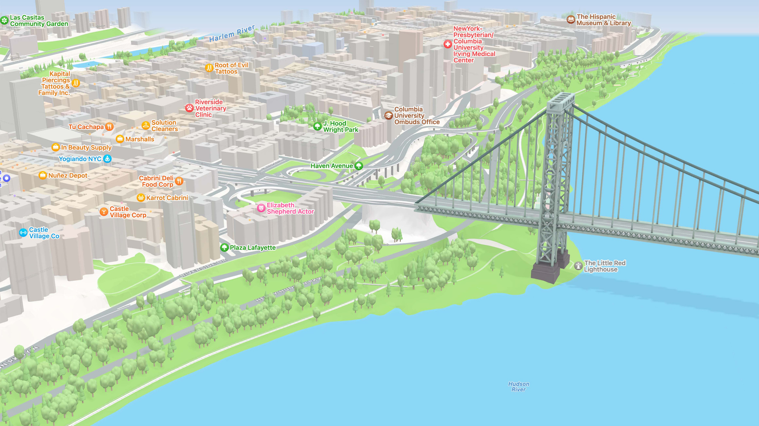
ParkSavvy
Value proposition
Customer: Saving money, reducing stress, making people's lives easier.
Tesla: Looking for an investment of $500,000 to benefit more people. The reason is to enhance the user experience for Tesla customers and expand into new markets.
200 new customers weekly
Major cities development
01
02
Notes:
We have 200 new customers weekly in San Francisco and we went to develop with us nationally .

Slide 5
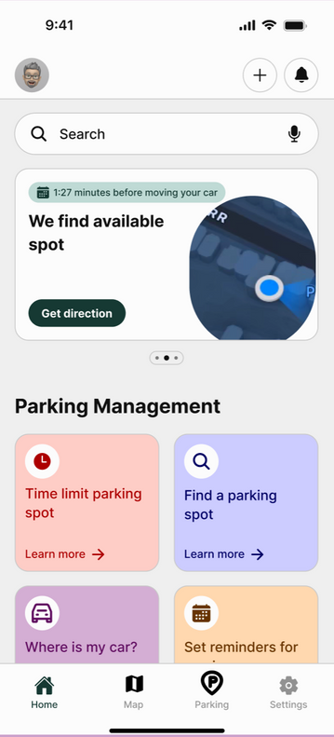
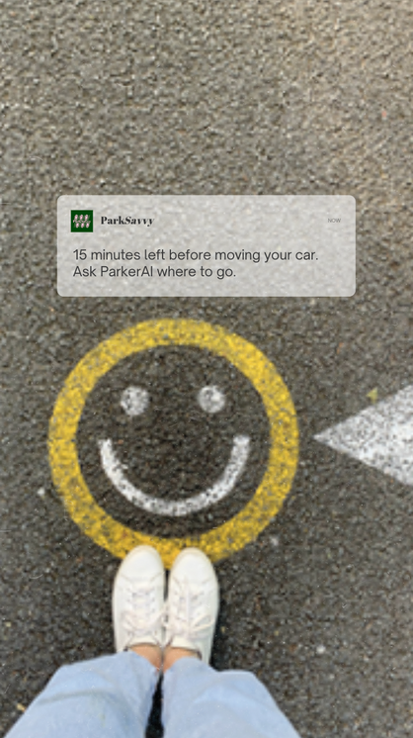
ParkSavvy
Problem
High Risk of Parking Tickets
01
Time Consumed Searching for Parking
02
Cost of Parking Tickets
03
Lack of Real-Time Parking Information
04
Notes:
Customers have a few problems that can have a quick solution to them. High risk of Parking tickets, Time spent searching for parking, cost of parking tickets, and the lack of real-time parking information in SF

Slide 6
ParkSavvy
Application Solution
Remind you 15 minutes before the time limit to move your car.
01
Help you find a parking spot quicker with our AI assistant that is based on the probability of available spots.
02
PayByPhone is integrated into our app, with other functionalities such as paying or claiming to avoid your SFMTA parking tickets directly on our app. Our experts will try to get it canceled.
03
Connect our app to CarPlay or other systems to find directions.
04
Notes:
Parksavvy will send you reminders to move your car on time, help you find new parking spots nearby, and include payment functionality such as Paybyphone or pay your tickets.

Slide 7
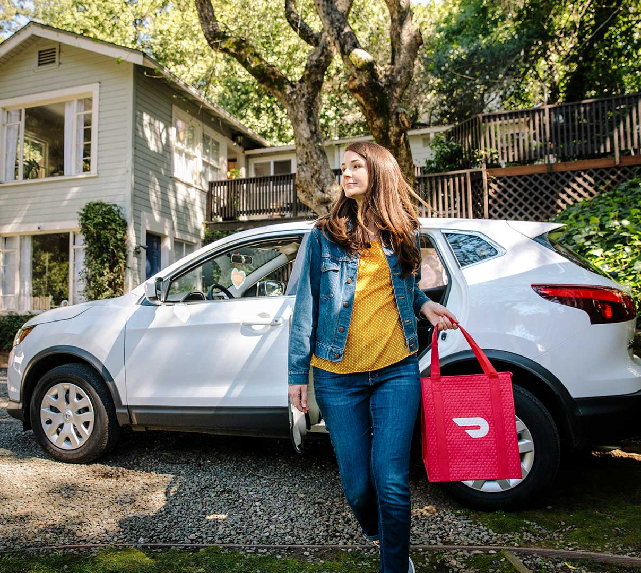
ParkSavvy
Market Validation
500,000 cars registered in San Francisco
1.5 million tickets are issued annually in San Francisco.
Notes:
Market validation: There are 1.5 million tickets issued annually in San Francisco for 5 hundred thousand registered cars, an average of 3 tickets given by cars. And $300 spend unnecessarily when could have just had a reminder on your phone.

Slide 8
ParkSavvy
Market size
Next year
Tomorrow
Approximately 31,300,000 vehicles registered across the 10 biggest cities in the U.S.
Today
Approximately 5,859,928 vehicles registered across the Bay Area counties
515,775 vehicles registerd in San Francisco
Los Angeles, New York City, Chicago, Houston, Phoenix, Philadelphia, San Antonio, Dallas and the Bay Area
Notes:
Our app is now small which I acknowledge and it can scare you, but the good news is that we are ready and we have the potential of new customers from the bay to nationwide. Leaving us space to grow.

Slide 9
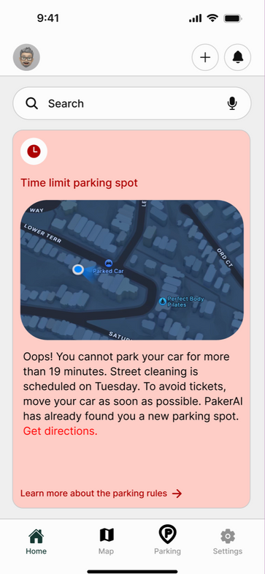
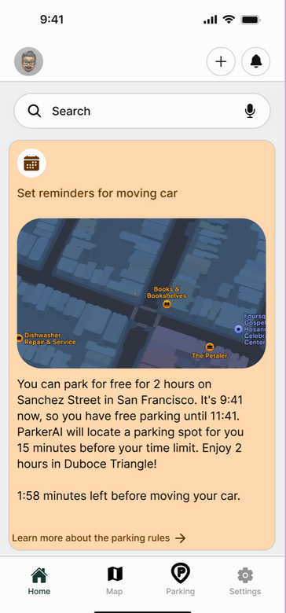
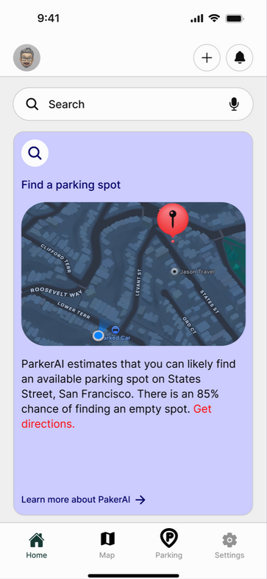
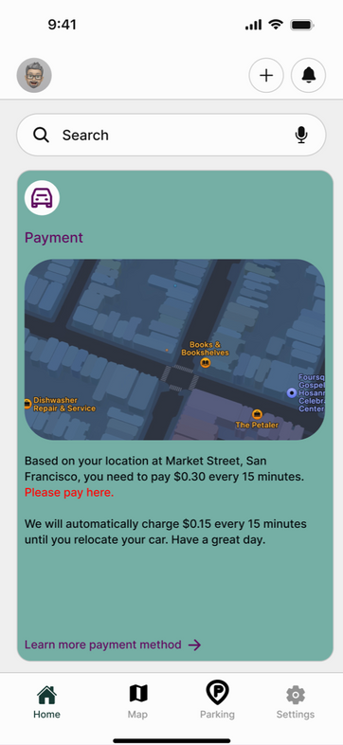
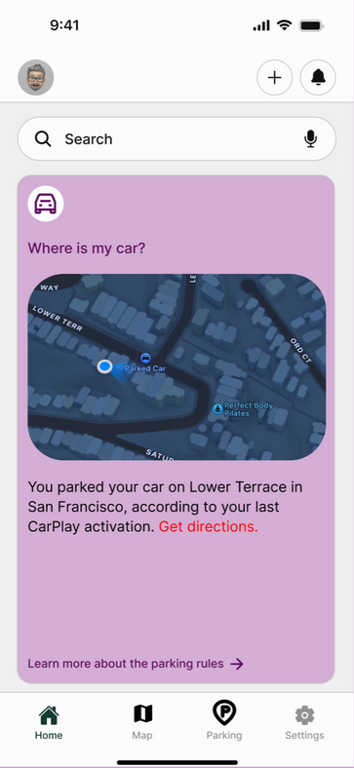
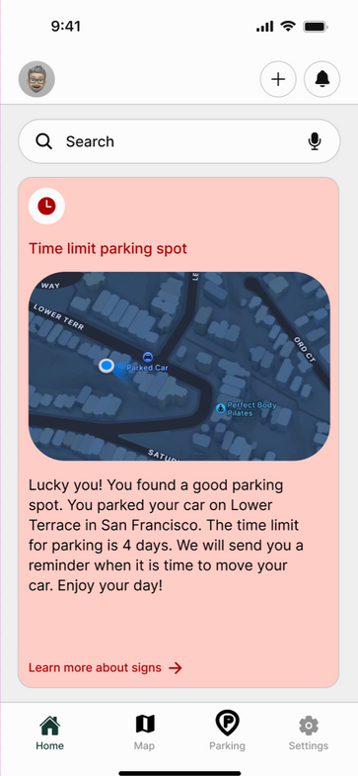
ParkSavvy
Benefits
Notes:
The benefit of the app for customers: with only icons on the app,l you will receive important information about parking rules through your location. Time limit parking spot, set reminders for your moving car, find a new parking spot, payments, where is your car, and much more.

Slide 10





ParkSavvy
Home
Photo
About Us
Contact
Buying motives
Free Version
Premium Version
- AI assistance
- Notifications
- Directions
- Latest updates
- Payment functionalities
- Real-time agent notifications
- Community access
$5 per month is all you need to park your car hassle-free with:
- Free version benefits
- Reserved parking spot nearby
- Parking spot size verification
- Priority support line
- No ads
Learn More
Learn More
Notes:
Buying motives: the app is completely free and includes diverse benefits but you can also pay for the premium version and if you have a Tesla is free to get a premium version of it, with more benefits.

Slide 11
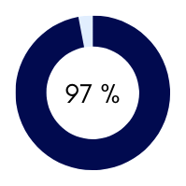

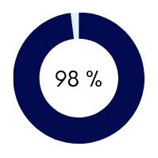
ParkSavvy
Share Research Data
Rate App
Customers
DoorDash users
Notes:
Our customers are happy and have a good experience using an app, they rate positively on the app store. randy a door dasher explains that we avoided 5 tickets for parking last month on Chestnut street.

Slide 12


ParkSavvy
Competitor
ParkSavvy
SpotHero
PayByPhone
AI-Powered
Nationwide
Parking Partnership
Real-Time Parking Assistance
User Reviews
Community
Advance booking
Notes:
Parksavvy has more benefits than its main competitor Spot Hero such as AI assistant and real-time parking assistance.

Slide 13




ParkSavvy
Home
Photo
About Us
Contact
Contact Us
+123-456-7890
www.parksavvy.com
parksavvy@parksavvy.com
123 Anywhere ST., San Francisco, CA 94114

Slide 14
ParkSavvy
Home
Photo
About Us
Contact
Thank You
Notes:
I hope you all are as excited as me for where we could take the Tesla app together! If this seems like it could be a good opportunity to explore more, should we plan to meet again next week to discuss potential collaborations? Thank you for your time!

